Slide 1


Evaluating Political Candidates
SS.7.C.2.9 Evaluate candidates for political office by analyzing their qualifications, experience, issue-based platforms, debates, and political ads.
Who would you choose?
Notes:
Also assesses: SS.7.C.2.7 Conduct a mock election to demonstrate the voting
process and its impact on a school, community, or local level.
Be sure to utilize Getting to the Point 3.8 with your class prior to presenting this activity/lesson for background knowledge.

Slide 2
What matters to you?
What characteristics do you think are most important when considering a presidential candidate?
Notes:
Debrief by having students compare their list with a partner or small group. Discuss as a class

Slide 3
What do you look for in a candidate?
Age
Religion
Gender
Educational background
Character
Occupation
Marital status
Personal appearance
Family history
Professionalism
Ethnic background
Prior government experience
Physical health
Criminal history
Military service
Socio-economic status
Notes:
In addition to the constitutional requirements/qualifications for the position, what else do you need to know about the political office? What about the duties of each office? Where would you find this information?

Slide 4
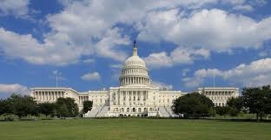
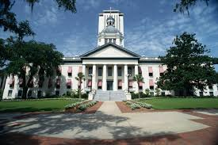
Who can run for political office?
Requirements on the federal and state level for the executive and legislative branches
Notes:
Tell students there are certain requirements in place for those who want to run for political office on the federal, state, and local level. Ask students to guess what some of the requirements might be. Divide the class into six groups. Each group will be given an excerpt of either the U.S. or Florida Constitution . Each student will also need the Running for Political Office chart. Students will need to complete the handout in their group based on the excerpt of the Constitution they received. Once they are finished, jigsaw the students into new small groups so they can share their answers to the handout. Debrief using the teacher handout.

Slide 5
Federal Government
President of the United States
Must be at least 35 years old
Natural born citizen of the US (cannot be naturalized!)
Resident of the US for 14 years
4 year term
Limited to 2 terms (10 years max)
Notes:
In addition to the constitutional requirements/qualifications for the position, what else do you need to know about the political office? What about the duties of each office? Where would you find this information?

Slide 6
Federal Government
U.S. Senate
At least 30 years old
Citizen of the US for at least 9 years
Must live in the state they wish to represent at the time of the election
6 year term
No term limits
Notes:
In addition to the constitutional requirements/qualifications for the position, what else do you need to know about the political office? What about the duties of each office? Where would you find this information?

Slide 7
Federal Government
U.S. House of Representatives
At least 25 years old
Citizen of the US for at least 7 years
Must live in the state they wish to represent at the time of the election
2 year term
No term limits
Notes:
In addition to the constitutional requirements/qualifications for the position, what else do you need to know about the political office? What about the duties of each office? Where would you find this information?

Slide 8
Government of the State of Florida
Governor of Florida
Must be at least 30 years old
Must be a citizen
Resident of Florida for the previous 7 years
4 year term
Limited to 2 terms
Notes:
Florida Constitution
Article III, Section 13
Article VI, Section 4
Article IV, Section 5

Slide 9
Government of the State of Florida
Florida Senate
Must be at least 21 years old
Must be a citizen
Resident of Florida for the previous 2 years AND live in the district from which they are elected
4 year term
Limited to 8 years in a row
Notes:
Florida Constitution
Article III, Section 13
Article VI, Section 4
Article IV, Section 5

Slide 10
Government of the State of Florida
Florida House of Representatives
Must be at least 21 years old
Must be a citizen
Resident of Florida for the previous 2 years AND live in the district from which they are elected
2 year term
Limited to 8 years in a row
Notes:
Florida Constitution
Article III, Section 13
Article VI, Section 4
Article IV, Section 5

Slide 11

Picking a Candidate
What do you look for in a candidate?
Notes:
The following slides will go over questions students should ask when evaluating candidates for political office.

Slide 12
Experience
What is their academic background?
What is/was their profession?
What political office(s) have they held in the past?
What else would you want to know about their past experience?
Notes:
Students will need to consider the experience candidates have when evaluating them for political office. Review the questions with them and ask why experience is so important in considering someone for political office. Review the qualifications for each political office and duties constitutionally. Focus on the President for this exercise.

Slide 13


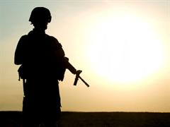
Platform
What are their ideas about government?
What are their policies on:
Economy
Environment
Health care
Immigration
National security/defense
…and more.
Notes:
Students should consider if they agree with a candidate’s ideas about government and their position on critical issues for our country. Which issues are most important to your students?
Where can you find information on candidate platforms? Look for specific political party websites to ascertain official platforms. Also you can look at the individual candidate’s website and other materials.

Slide 14

Debates
What do they know about the issues?
How informed is the candidate?
How well do they communicate?
How professional are they during a debate?
Does the candidate demonstrate ethical conduct?
Notes:
Debates are a key opportunity to not only determine where a candidate stands on the issues, but also to evaluate their depth of knowledge, communication skills, and professional demeanor.
Ask your students if they have ever watched a Presidential Debate.

Slide 15

Political Advertisements
What do they say about themselves?
What do they say about their opponents?
And, what do their opponents say about them?
What evidence is provided to support their claims?
Notes:
Ask students to think about political advertisements they have seen. What did they learn from the ad? Discuss the questions provided as a means of assessing political advertisements.
You can review past political advertisements and evaluate using the Living Room Candidate website.
Note: political advertisements will be addressed more in depth with Benchmark 2.11 where students will evaluate ads for bias, propaganda, and symbolism.

Slide 16
Who might be more qualified? Just based on the information below, who would you say is more qualified for political office?
Vote
Sadie Moyes
For State Representative
Served as Student Government President at Sunshine University
Lived in Florida for the past 4 years
Studied political science at Sunshine University
Vote
Mitchell Macabee
For State Representative
Florida resident since age 2
Studied political science at Everglades University
Served as Mayor of Sunshine, FL
Served as City Commissioner of Sunshine, FL
Notes:
Ask students for their responses. Mitchell Macabee has been a resident of the state longer and has held political office in the past, serving as both a mayor and a city commissioner.

Slide 17
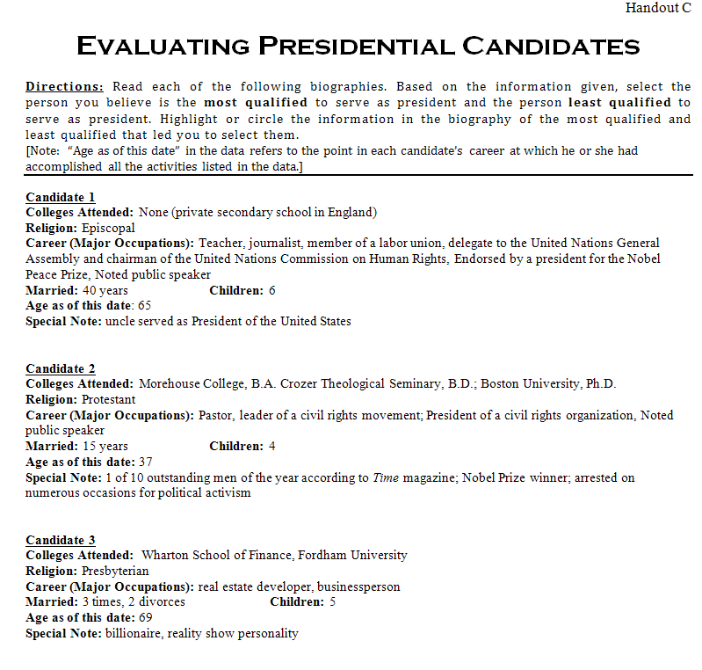
Evaluating Presidential Candidates
Read the campaign speeches of the three candidates listed in Part C. Follow the directions to highlight in different colors their qualifications and promises.
Notes:
Working individually, students will need to read through the biographies of the anonymous candidates. After evaluating the information provided, students should select the person they feel is the most qualified and the least qualified to serve as President of the United States. Students should highlight (underline or circle) the information they used to make their selections.
While the students are reading through the handout, create a chart with 10 columns labeled 1-10. After students make their selection, they should walk up front and place an M (most qualified) and L (least qualified) on the chart in the column for the appropriate candidate.

Slide 18
Who did you pick?
Which candidate did you think was the most qualified? The least qualified?
Notes:
While the students are reading through the handout, create a chart with 10 columns labeled 1-10. After students make their selection, they should walk up front and place an M (most qualified) and L (least qualified) on the chart in the column for the appropriate candidate. Debrief by discussing who the students have selected as the most qualified and the least qualified and revealing the identities of the candidates.

Slide 19
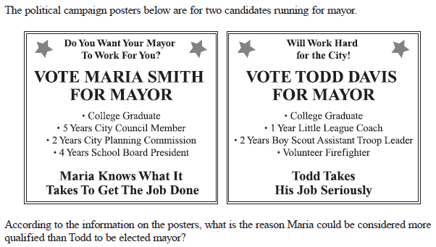

Checking for Understanding
Notes:
Have students eliminate distractors. Political policies and campaign promises are not provided on either poster. Both candidates are college educated. By reading the content and process of elimination, the answer is D.
Reviewing test-taking strategies with students, like eliminating two of the options, is a beneficial exercise.

